Slide 1
Languages in the social world of indigenous Siberia: evidence from Lower Yenisei
Olesya Khanina
Institute of Linguistics RAS & Finno-Ugrian Society & University of helsinki

Slide 2
Introduction 1
multilingual Lower Yenisei area in Siberia
a comprehensive study of the sociolinguistic landscape
illuminating parallels between indigenous communities in the Northern Siberia and
Australia (Merlan 1981, Singer 2018),
West Papua (de Vries 2012),
Vanuatu (Francois 2012),
Amazon (Aikhenvald 2003, Ball 2011),
Arizona (Kroskrity 2018),
Africa (Childs et al. 2014).

Slide 3
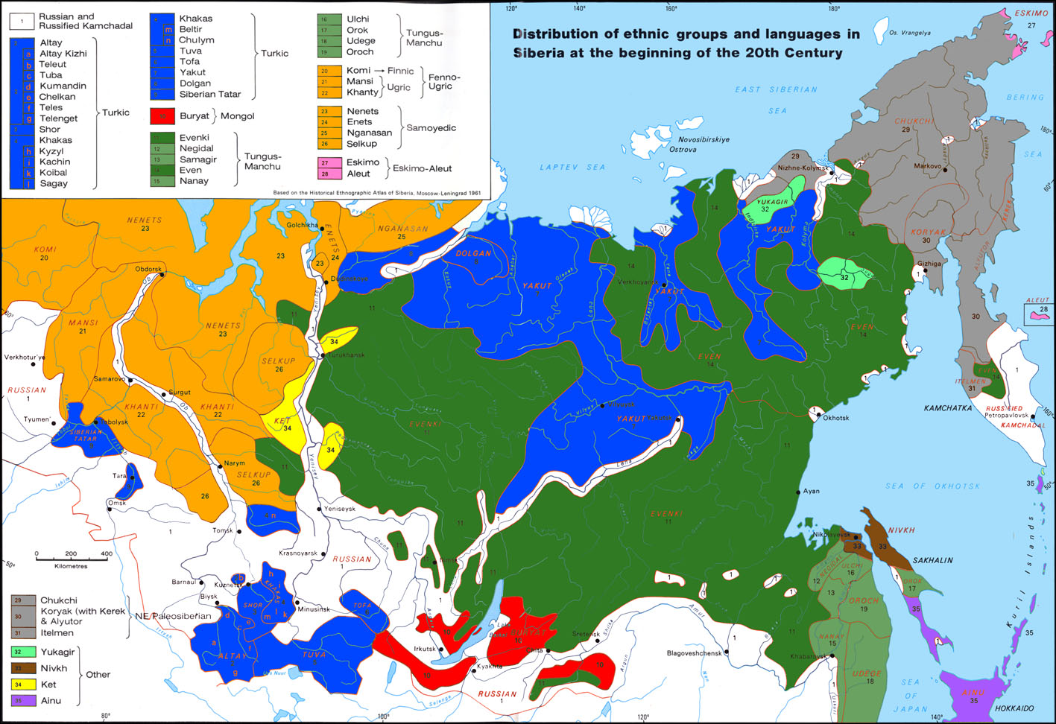

Slide 5
Introduction 2
Recurrent patterns are attested in these indigenous multilingual communities:
absence of hierarchical and one-to-one relationships between social units, types of materials culture, and languages,
shared cultural knowledge and principles of interactions irrespective of particular codes,
relational identities and ideologies deemphasizing linguistic contributions to these identities.
-> basic mechanisms of (a version of) the precolonial sociolinguistic past?

Slide 6
Outline
Introduction
Lower Yenisei case
The typology
Language ideologies as a theoretical framework for the present study (e.g. Kroskrity, 2000; Rumsey, 1990; Silverstein, 1979; Woolard, 1998).
Khanina, Olesya. 2021. Languages and ideologies at Lower Yenisei (Siberia): reconstructing past multilingualism, International Journal of Bilingualism (Typology of Small-Scale Multilingualism, edited by Nina Dobrushina, Olesya Khanina, and Brigitte Pakendorf).

Slide 7
Lower Yenisei: methodology
A retrospective study: 1900-1930s, just before the sovietization of this part of Russia marked by
externally driven changes in subsistence modes: collective farms, nationalizations of reindeer, etc.,
imprisonment of shamans and rich(=efficient) reindeer herders,
fleeing of indigenous locals to less accessible areas (=away from the Yenisei river),
obligatory school education in Russian, in boarding schools,
Russian as lingua franca,
a rapid language shift to Russian: not a single children speaking an indigenous language today
How to access a sociolinguistic setting in the past?
Dobrushina (2013): retrospective interviews
Dobrushina & Moroz (2021), Pupynina & Aralova (2021): census data

Slide 8
Lower Yenisei: data
the 1926 census data,
ethnographic field reports from 1920s-1960s,
narratives collected in the 1940s (also Khanina & Meyerhoff 2018),
35 retrospective sociolinguistic interviews from 2017 (also Khanina 2019),
ethnonyms of local languages (based on corpora of respective languages).
(With a background of my language documentation fieldtrips 2005-2017.)
(a)-(b) provide a background for the interpretation of (socio)linguistic data (c)-(e).
An ethnographic approach is taken, which interprets sociolinguistic data in view of emic categorizations.

Slide 9
Lower yenisei: area & languages
Nenets, Forest Enets, Tundra Enets, Nganasan: Northern Samoyedic (< Uralic)
Forest Enets is very similar to Tundra Enets
Dolgan: Turkic
Very low population density: ca. 200 * 500 km
~ 2 000 (semi-)nomadic indigenous people,
~ 35 000 reindeer,
~ 500 Russian colonizers in villages along Yenisei.
An extended family in 1-2 tents; several tents could often be seen together: family and/or labor ties.
The different families tended to remain together over longer periods, but nothing similar to a ‘village’ was typical for the area.
Focus area of this paper

Slide 10
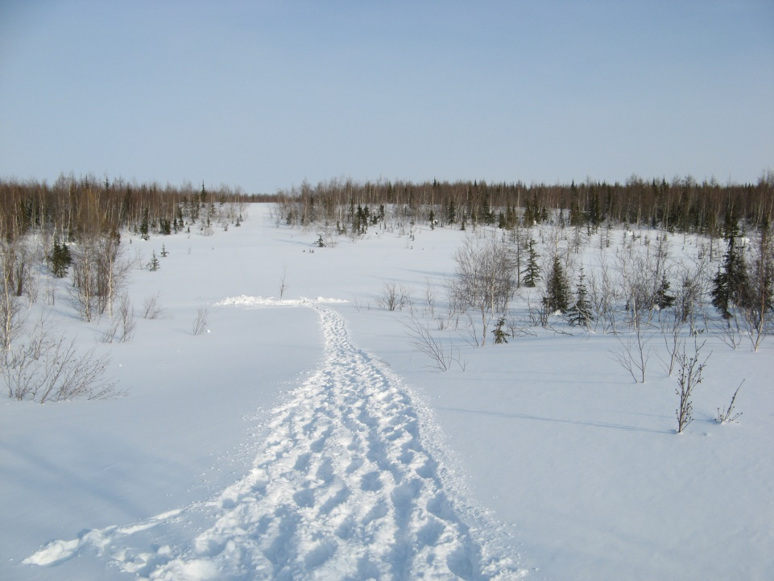
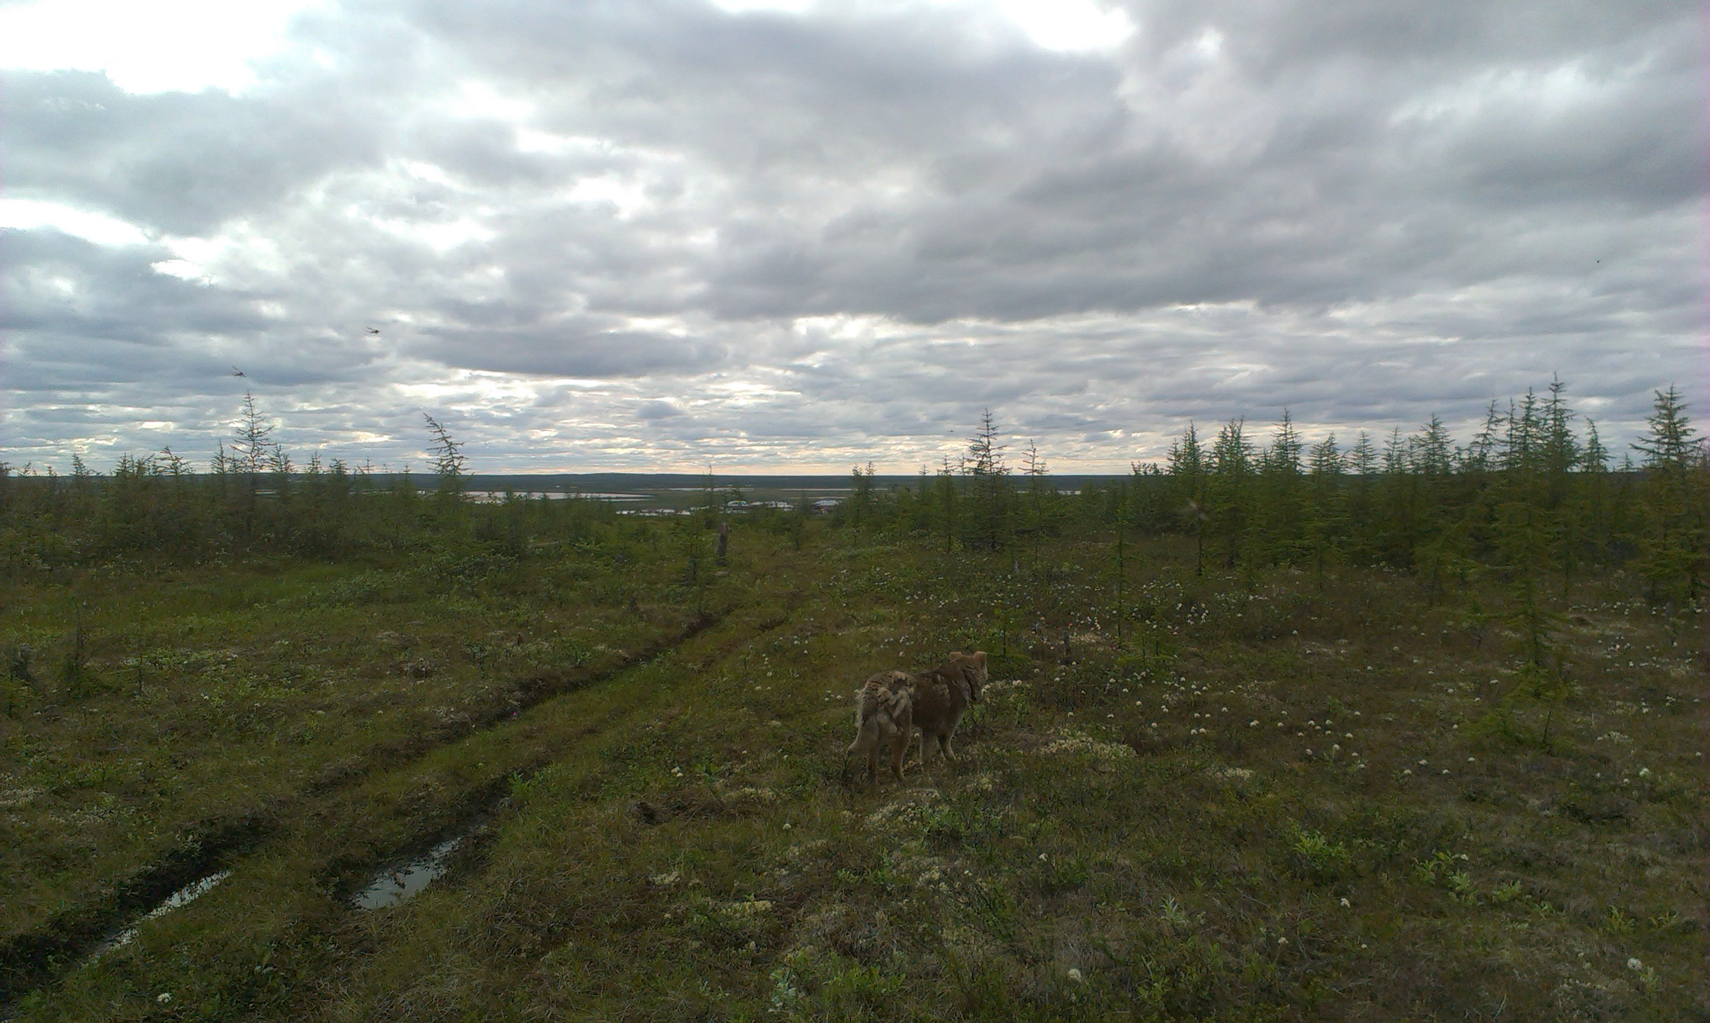
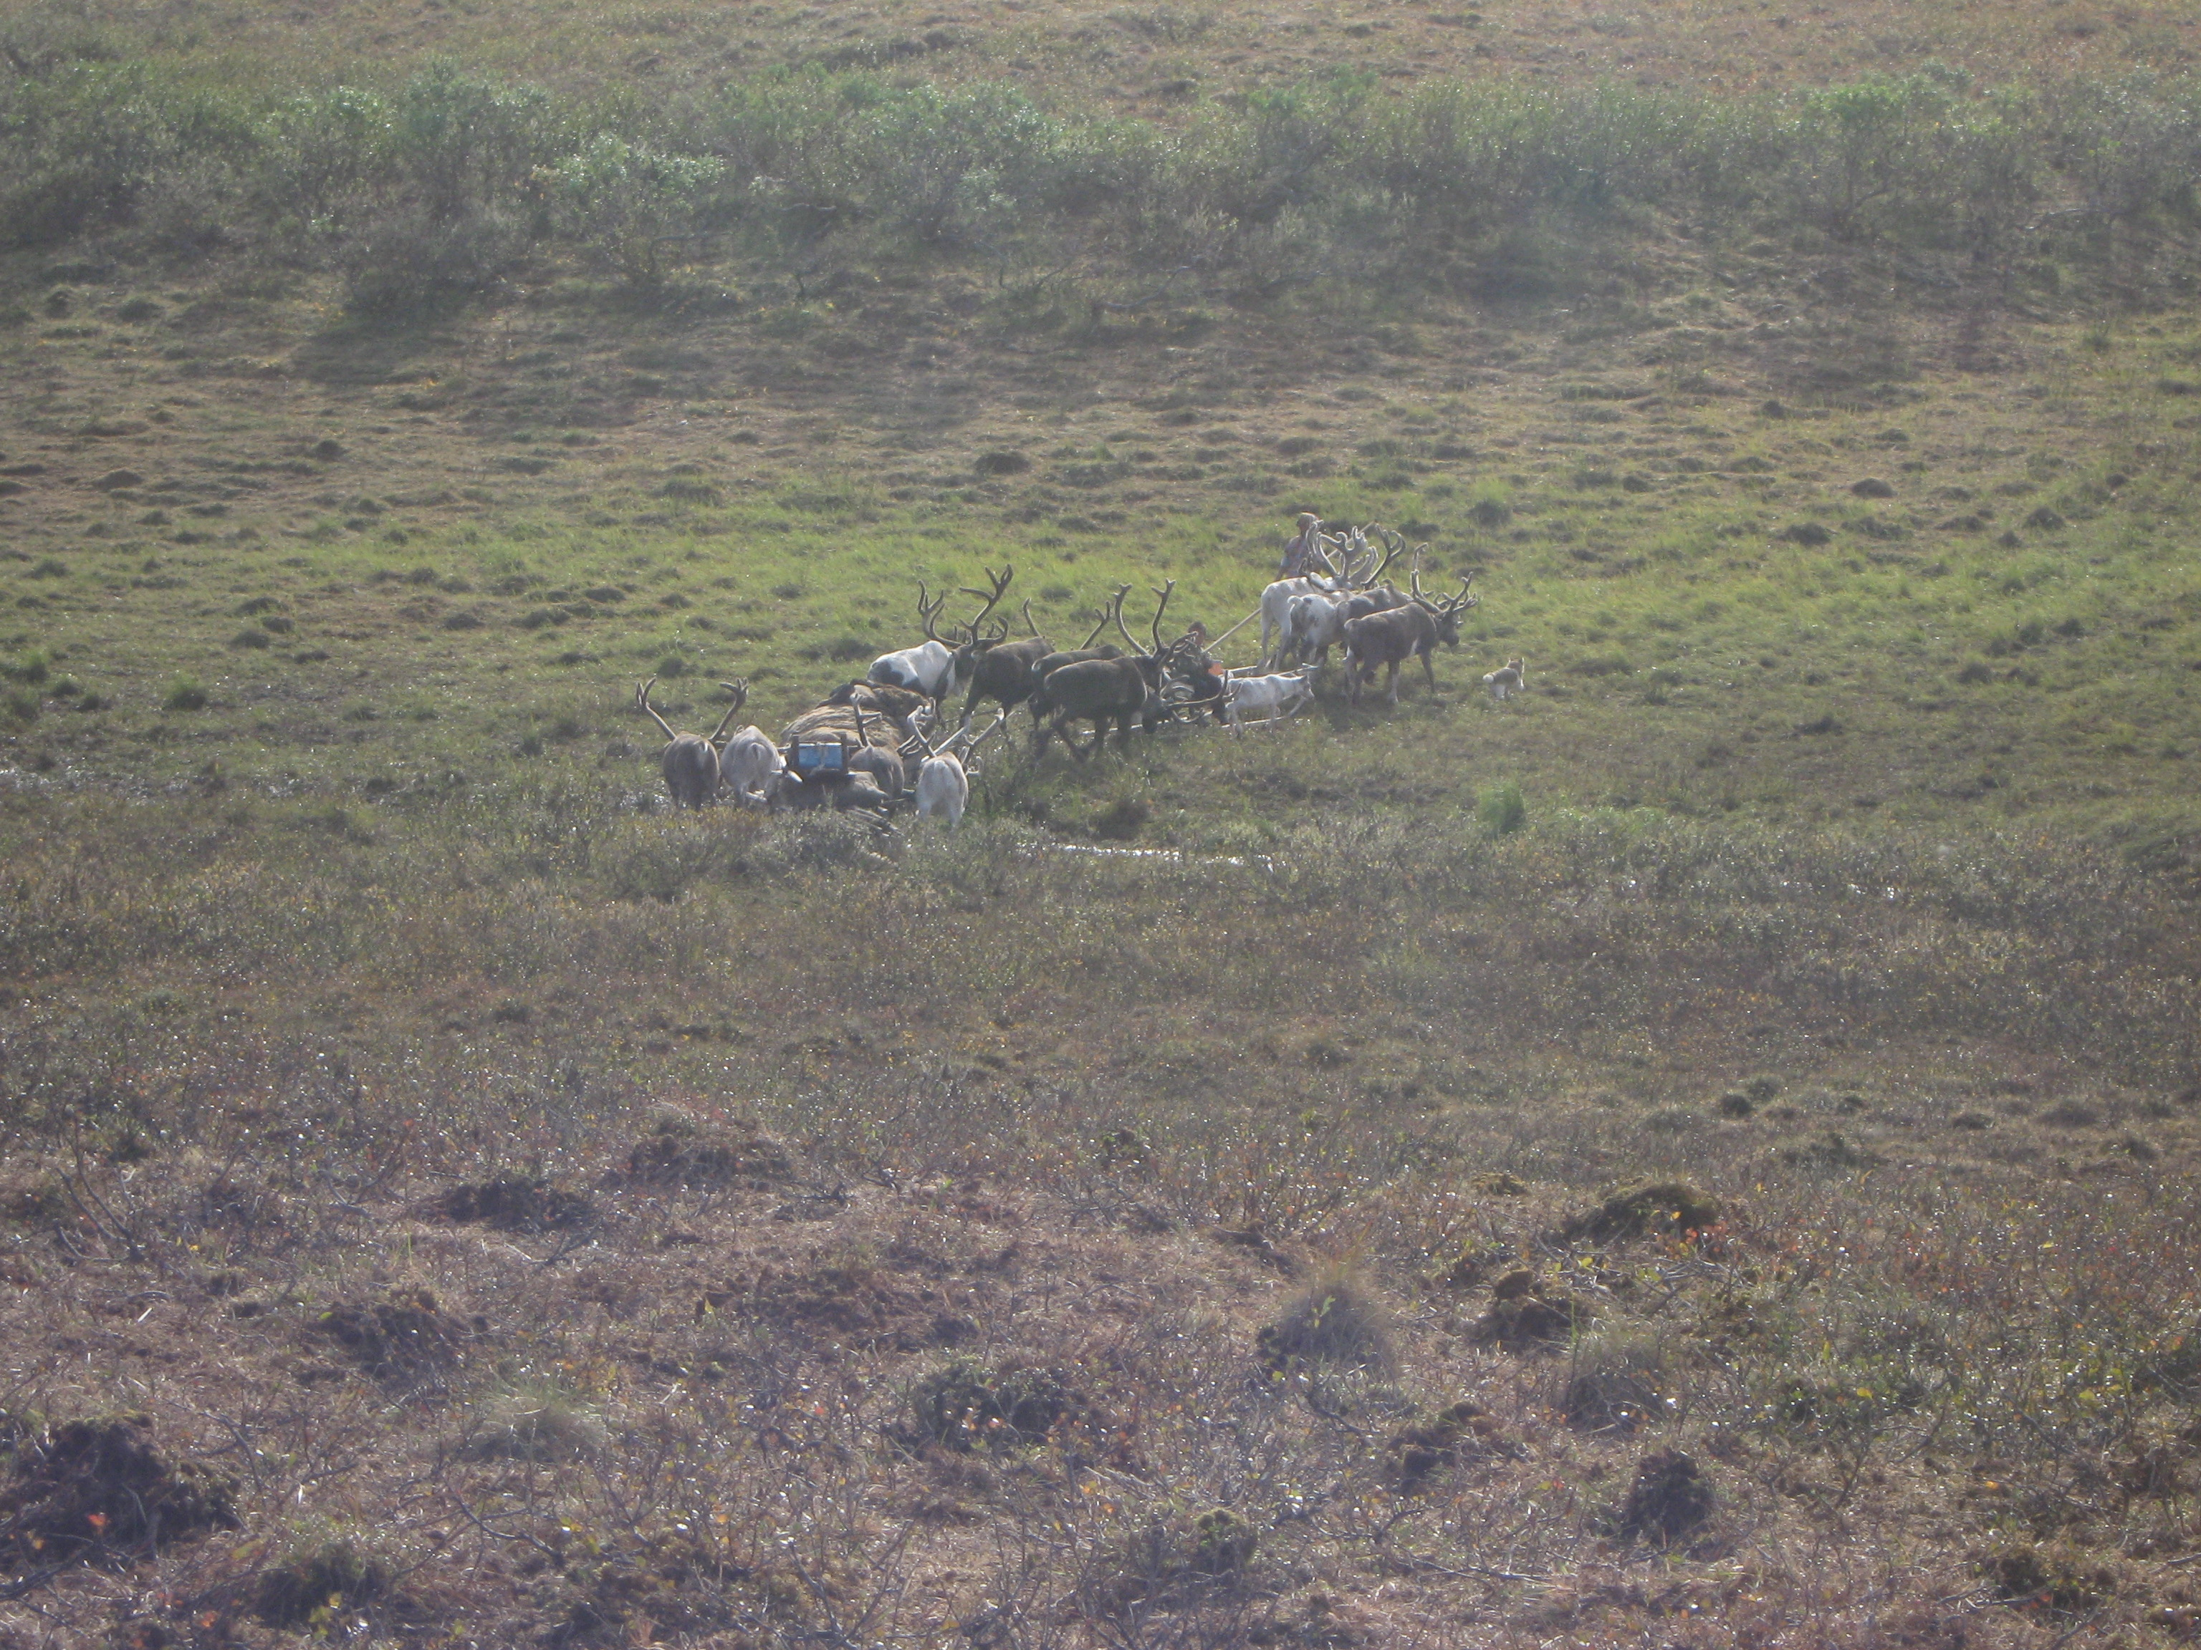

Slide 11
Lower yenisei: area & languages
All indigenous people practiced the same type of activities, so no barter exchange or trade.
However, domestic reindeer of bigger herds were exchanged from time to time to ensure the better health of reindeer population: not with families in direct neighborhood, but with the more distant ones.
Every spring (March-April): an important custom of paying and hosting visits
in-married spouses would visit their parents and the rest of the family,
moments of the most social interaction.
People rarely met complete strangers: anyone met could be connected to someone already known.
The physical distance between individual families was only a weak correlate of the social distance between them, and networks were supported rather by marriages and regular visits than by direct geographic proximity.
Communities of this Arctic area were much looser than elsewhere.

Slide 12
Nenets, Nganasan, and Dolgan had monolingual speakers beyond Lower Yenisei, Tundra Enets and Forest Enets were spoken only here.

Slide 13
Local social categorizations
Russian colonizers were set apart by their sedentary lifestyle, their residence exclusively in villages, their subsistence patterns (trade in addition to hunting and fishing), and their language.
All the other local people could be categorized by their clans and patterns of material culture
There were also categories of a higher order: so-called ethnic groups, but they were not as unambiguous and mutually exclusive as the first two.
To understand their logic, I study ethnonyms of local languages.
Mapping these social categories to languages is not trivial: no one-to-one correspondence.

Slide 14
clans
patrilineal and unambiguous, the most basic social grouping
~40 clans in the area
clan-based exogamous marriages
Each clan counted from a handful to several dozens of members at any given time.
Clans could disappear with time, due to illnesses and exogamous marriages.
Multidirectional language shifts by clans or their fractions over the past centuries:
clans switched from one language to another,
family (=blood) connections between clans currently speaking different languages.

Slide 15
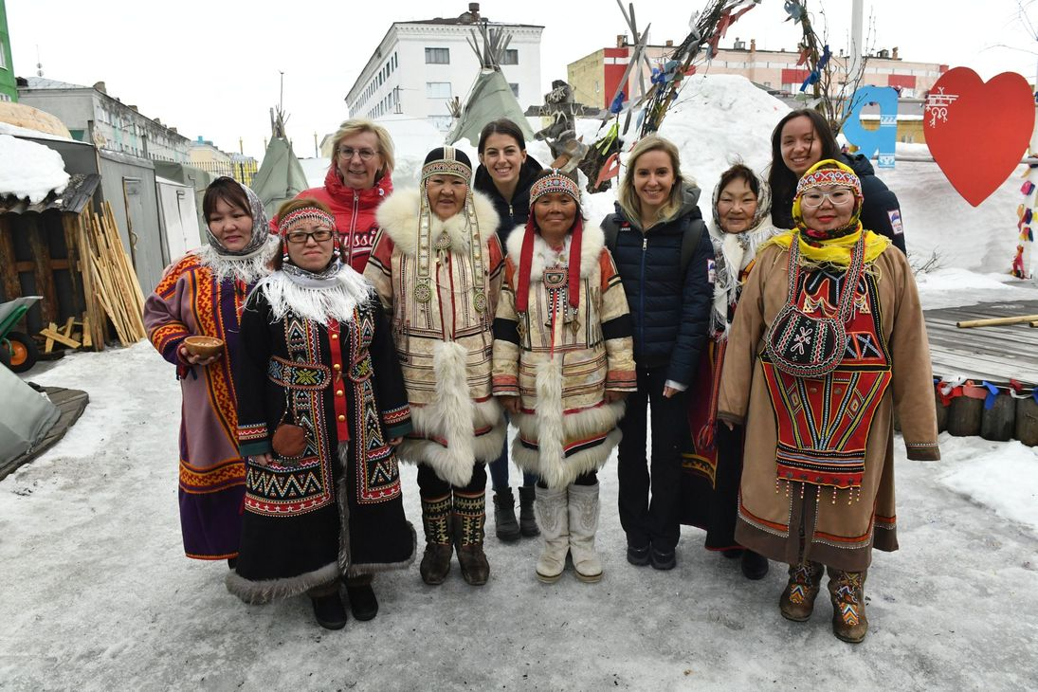
Patterns of Material culture
Nganasan
Forest Enets
Evenki
Clothes, dwellings, sledges, etc.
Drastic difference: Dolgan vs. Northern Samoyedic
Smaller differences: Nganasan & Tundra Enets vs. Nenets & Forest Enets
Nenets
Dolgan
Picture from 2019 https://www.ttelegraf.ru/news/v-gostjah-u-nganasan/

Slide 16
‘Ethnic’ groups
Exonyms and endonyms of 6 local lects, including the local Russian of the 1930s, point to the existence of 6 named groups in most of them.
BUT
some local languages merge some of these six groups in their lexicons,
Tundra Enets & Nganasan, Forest Enets & Nenets, Forest Enets & Tundra Enets, Tundra Enets & Nganasan & Forest Enets, Tundra Enets & Nganasan & Forest Enets & Nenets
some languages lack original endonyms
Tundra Enets: borrowed from Nganasan (earlier) and Nenets (later)
Forest Enets, Dolgan: no endonyms, self reference by clan names only, endonyms were invented by Soviet ethnographers and linguists in the 1930s
some words have changed their meaning in the course of just several decades.

Slide 17
Name of a representative of the group | (1) | (2) | (3) | (4) | (5) | (6)
in Nenets | jurak° | (pʲa) waj | manto | tawis | tuŋgos | lusa
in Nganasan | d’üriakə | bai | səmaʔtu | ńaa | aśa | l’üəʔsa
in Tundra Enets | dʲurako | (pe) baj | sɔmatu, mandu 1930: ɔnej enetʃeɁ | tau, 1930: ɔnej enetʃeɁ | ɔʃa | losa
 | ɔnej enetʃeɁ
in Forest Enets | dʲurako | ɔnɛj entʃeɁ 1930: pebaj | madu (also tau) | tau (also madu) | ɔʃa | losa, rosa
 | ɔnɛj entʃeɁ
in Dolgan | d'urak, n’en’ec | ? | ha:maj |  | dalga:n, dulga:n, haka | n'uːčča, nuːčča
 |  | en’ec |  | nganasan, nganasan'in
in local Russian of the 1930s | jurak |  | xantajskij samod'in, xantajskij, somatu | avamskij samod'in, tau, avamskij tau, avamskij | dolgan | russk'ij, krest’janin
 | jurak | karasinskij samod’in, karasinskij (also baj, muggad’i, chor...)
 |  | samod’in
in modern local Russian | n'en'ec, tuxardskij | potapovskij, potapovskij enec | voroncovskij, voroncovskij en'ec, somatu | nganasan(in), avamskij | dolgan('in) | russk'ij
 |  | en'ec
in academic English | a Nenets | a Forest Enets | a Tundra Enets | a Nganasan | a Dolgan | a local Russian of the 1930s
Merges are shown in bold

Slide 18
‘Ethnic’ groups and languages
language shifts between clans did not necessarily lead to shifts in emic social categorizations (‘outsiders that acquired our language’), i.e. a shared language did not automatically mean a shared social identity
mismatches ‘named ethnic groups' <-> ‘languages' attested in the 1926 census
77% of those who named themselves Tundra Enets said their language was TE, the others chose Nenets
53% of those who named themselves Forest Enets said their language was FE, the others chose TE
84% of those who named themselves Nenets said their language was Nenets, the others chose FE or TE
50% of those who said they spoke TE, declared themselves as belonging to a different ‘ethnic’ group: FE, Nenets
holders of traditional knowledge in a particular language could function as such regardless their membership in a different ‘ethnic’ group
academic fieldtrips to the area: locals send researchers to Nganasans for traditional TE stories in TE or to TEs for traditional Nganasan stories in Nganasan

Slide 19
Social categories and languages
Summing up, at Lower Yenisei we see
no uniformity in categorization by ‘ethnic groups’,
no direct correlations between languages and social categories (neither clans, nor ‘ethnic’ groups)
numerous diachronic changes in social categories and languages spoken by their members.
Anderson (2000), an ethnographer’s view: the complexity and flexibility of ethnic categories at the Lower Yenisei river is not a chaotic mess, but a reflection of a profoundly distinct social world.
$➠$Multilingualism was a logical counterpart of this social order on the linguistic side.

Slide 20
Aspects of multilingualism 1
Language use within families and child language acquisition
Ca. 50% of all marriages in the area were mixed, i.e. multiethnic (the 1926 census).
In multiethnic families, one language was usually chosen for communication with children, usually the one that was heard the most often in the whereabouts of the family
occasionally, the language of the husband could be chosen even if in the minority
the linguistic majority of the focus area was Enets, with TE in the north and FE in the south, and so this contributed to the maintenance of TE and TE despite numerous speakers of other languages around.
It was rare for each parent to practice speaking different languages to the children.
When communicating between themselves, parents used the same language as chosen for communication with children, or they spoke each their own language (=receptive bilingualism).
This often vanished with time as the spouse with the minority language acquired the other language.
Children usually acquired their second and third languages when playing with their peers and while listening to the adults conversing with visitors to their tents.

Slide 21
Aspects of multilingualism 2
Language use beyond the family
Everyone could at least understand all languages regularly used around them, and often also speak them.
Remember the relatedness of most local languages!
Adults whose native language was not practiced in the family used every opportunity to speak it, either with adults from the same ‘ethnic’ group or with those having a good command of it.
Remember the spring visits!
It was also common to use the language of one's interlocutor: a kind of politeness often conditioned by practical needs (if one needs something from his/her interlocutor).
Little emblematic value: no language was seen as better than the others, and one's repertoires did not influence one's social weight.
It was the multilingualism per se that was appreciated in contrast to any single local language.
The most respected adults were usually multilingual, just because rich life experience inevitably presupposed confronting many people and thus acquiring many languages.

Slide 22
The Cross-linguistic parallels
At LY, communities (at least those with many speakers of Tundra Enets or Forest Enets) were defined not so much by the command of a language, but by the confluence of commands of several languages.
Ball (2011) for Upper Xingu in Amazonia,
Morozova & Rusakov (2021) for a Balkan area,
Childs et al. (2014) for Sub-Saharan Africa,
Kroskrity (2018) for California
provide further cross-linguistic parallels to speech communities where linguistic repertoires are more reliable "loci of authenticity" than single languages (wording from Kroskrity, 2018: 134).
Speech communities

Slide 23
the Cross-linguistic parallels
At LY, linguistic identities did not play a decisive role in social identities, or local social identities were of relational nature, with several diverse components making up a complex social self
Singer (2018: 107-108) for Australia: “languages are not necessarily the most important aspects of people's identities at Warruwi”.
De Vries (2012: 15) for West Papua: "languages transcend the boundaries of the clan, and speakers of the same language live on a different clan territory and may be your enemies”, non-hierarchical complexity of relational identities - linguistic, cultural, and political.
At LY, linguistic indexing of identity relied more on local social networks than on ancestry: choosing the language to use with their children, parents valued neighborhood above kinship.
(François, 2012: 91) for Vanuatu: in marriages across islands the dominant language of the household is usually the language of the village where the couple has chosen to live.
NB: a common reason for language shifts worldwide, but at LY all languages were shifted from and shifted to, so languages were equal in this respect.
Identities

Slide 24
conclusion
If multilingualism was one of the primal human conditions (Evans 2017), some of the features of small-scale multilingual societies could be much more common in the past.
Among them,
no one-to-one correspondence between languages and social categories/units,
speech communities as opposed to language communities,
relational identities where language is just a component of a complex social self.

Slide 25
p.s.
My way through this study:
data collected in the field
with very limited sociolinguistic background, I am a descriptive linguist and a typologist by training!
first generalizations: "languages are not important in the local social world" - how could this be??
review of the literature devoted to ideologies shared by small-scale multilingual societies (as a part of Pakendorf, Dobrushina & Khanina 2021)
noticing the same ideological patterns in my data.

Slide 26
references
Anderson, D. (2000). Identity and ecology in arctic Siberia. OUP.
Ball (2011). Pragmatic multilingualism at the Upper Xingu speech community // Franchetto, (ed.). Alto Xingu: uma sociedade multilíngue. Rio de Janeiro, 87-112.
Childs, Good & Mitchell (2014). Beyond the Ancestral Code, Lang. Document. & Conserv. 8, 168-191.
de Vries (2012). Speaking of clans, Int’l. J. Soc. Lang. 214, 5 – 26.
Dobrushina, N. (2013). How to study multilingualism of the past: Investigating traditional contact situations in Daghestan. Journal of Sociolinguistics 17 (3), 376-393.
Evans. 2017. Did language evolve in multilingual settings? Biology & Philosophy, 32(6), 905–933.
François (2012). The dynamics of linguistic diversity, Int’l. J. Soc. Lang. 214, 85–110.
Khanina, O. (2019). Dinamika mnogojazyčija v nizov’jax Eniseja: opyt sociolingvističeskogo opisanija situacii v prošlom. Tomsk Journal of Linguistics and Anthropology, 23, 9-28.
Khanina, O., & Meyerhoff M. (2018). A case-study in historical sociolinguistics beyond Europe: reconstructing patterns of multilingualism of a language community in Siberia. Journal of Historical Sociolinguistics, 4(2), 221–251.
Kroskrity (2018). On recognizing persistence in the Indigenous language ideologies of multilingualism in two Native American Communities. Lang. & Comm. 62, 133–144.

Slide 27
references
Kroskrity, P. (2000). Language ideologies in the expression and representation of Arizona Tewa identity. In P. Kroskrity, (Ed.), Regimes of language: Ideologies, polities, and identities (pp. 329-359). School of American Research Press.
Merlan (1981). Land, language and social identity in Aboriginal Australia. Mankind Quarterly 13(2), 133–148.
Morozova, M. & Rusakov, A. (2021). Societal multilingualism à la balkanique: the Montenegrin Velja Gorana and beyond. International Journal of Bilingualism (Typology of Small-Scale Multilingualism, edited by N. Dobrushina, O. Khanina, B. Pakendorf).
Pakendorf, B., Dobrushina, N., & Khanina, O. (2021). A typology of small-scale multilingualism. International Journal of Bilingualism (Typology of Small-Scale Multilingualism, edited by N. Dobrushina, O. Khanina, B. Pakendorf).
Pupynina, M. & Aralova, N. (T2021). Lower Kolyma multilingualism: Historical setting and sociolinguistic trends. International Journal of Bilingualism (Typology of Small-Scale Multilingualism, edited by N. Dobrushina, O. Khanina, B. Pakendorf).
Rumsey, A. (1990). Wording, meaning, and linguistic ideology. American Anthropologist, 92(2), 346–361.
Silverstein, M. (1979). Language structure and linguistic ideology. In P. Clyne, W. Hanks, & C. Hofbauer (Eds.), The elements: A parasession on linguistic units and levels (pp. 193–247). Chicago Linguistic Society.
Singer (2018). A small speech community with many small languages, Lang. & Comm. 62, 102–118.
Woolard, K. (1998). Introduction: Language Ideology as a Field of Inquiry. In B. Schieffelin, K. Woolard, & P. Kroskrity (Eds.), Language Ideologies. Practice and Theory (pp. 1–47). Oxford University Press.

